Slide 1
Module - 3
New Venture Planning

Slide 2
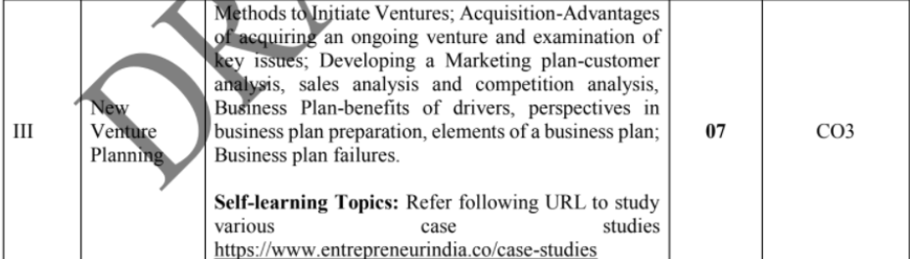

Slide 3
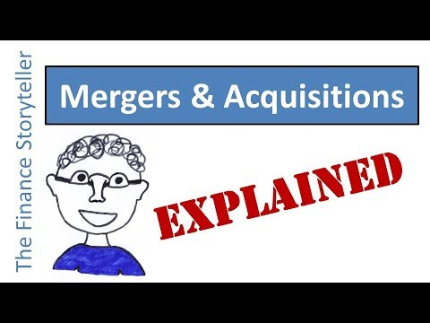

Slide 4
On going business
https://smallbusiness.chron.com/advantages-buying-ongoing-business-80659.html
Existing business
https://www.forafinancial.com/blog/small-business/pros-cons-buying-existing-business/
https://www.slideshare.net/guest81462b/topic-6-starting-a-new-entrepreneurial-venture
Case_studies https://www.entrepreneurindia.co/case-studies/5/case+study+1

Slide 5


The Pathways to New Ventures for Entrepreneurs
Creating the New Venture
Acquiring an Existing Venture
Pathways to New Ventures
Obtaining a Franchise

Slide 6
Creating New Ventures
Approaches to Creating a New Venture
New-New Approach
New-Old Approach

Slide 7
^{Table} 7.1 Trends Creating Business Opportunities
Emerging Opportunities
Green Products Organic foods Organic fibers/textiles Alternative Energy Solar Biofuel Fuel cells Energy conservation | Health Care Healthy food School and govt.-sponsored programs Exercise Yoga Niche gyms Children Nonmedical Pre-assisted living Assisted living transition services | Niche Consumables Wine Chocolate Burgers Coffee houses Exotic salads | Home Automation and Media Storage Lighting control Security systems Energy management Comfort management Entertainment systems Networked kitchen appliances
Emerging Internet Opportunities |  |  | Emerging Technology Opportunities
Mobile Advertising Cell phones PDAs Concierge Services Niche Social Networks Seniors Music fans Groups of local users Pet owners Dating groups | Virtual Economies Online auctions Educational Tutoring Human Resources Services Matchmaking Virtual HR Online Staffing |  | Nanotechnology Wireless Technology
Source: Steve Cooper, Amanda C. Kooser, Kristin Ohlson, Karen E. Spaeder, Nichole L. Torres, and Sara Wilson, “2007 Hot List,” Entrepreneur (December 2006): 80–93.

Slide 8
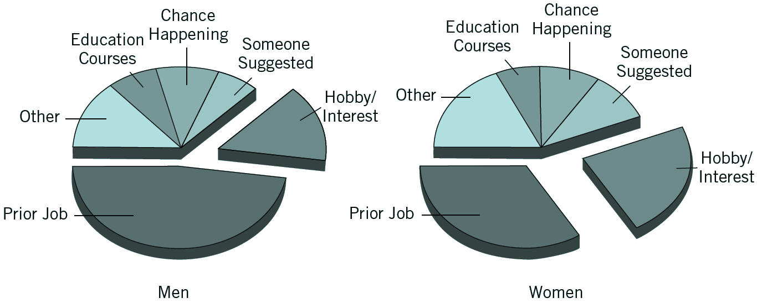
^{Figure} 7.1 Sources of New Business Ideas Among Men and Women
Source: William J. Dennis, A Small Business Primer (Washington, DC: National Federation of Independent Business, 1993) 27. Reprinted with permission.

Slide 9
Examining the Financial Picture When Creating New Ventures
Upside gain and downside loss expectations
The profits the business can make and the losses it can suffer.
How much money will the enterprise take in if all goes well?
How much will it gross if operations run as expected?
How much will it lose if operations do not work out well?
Risk vs. reward analysis
Points out the importance of getting an adequate return on the amount of money risked.

Slide 10
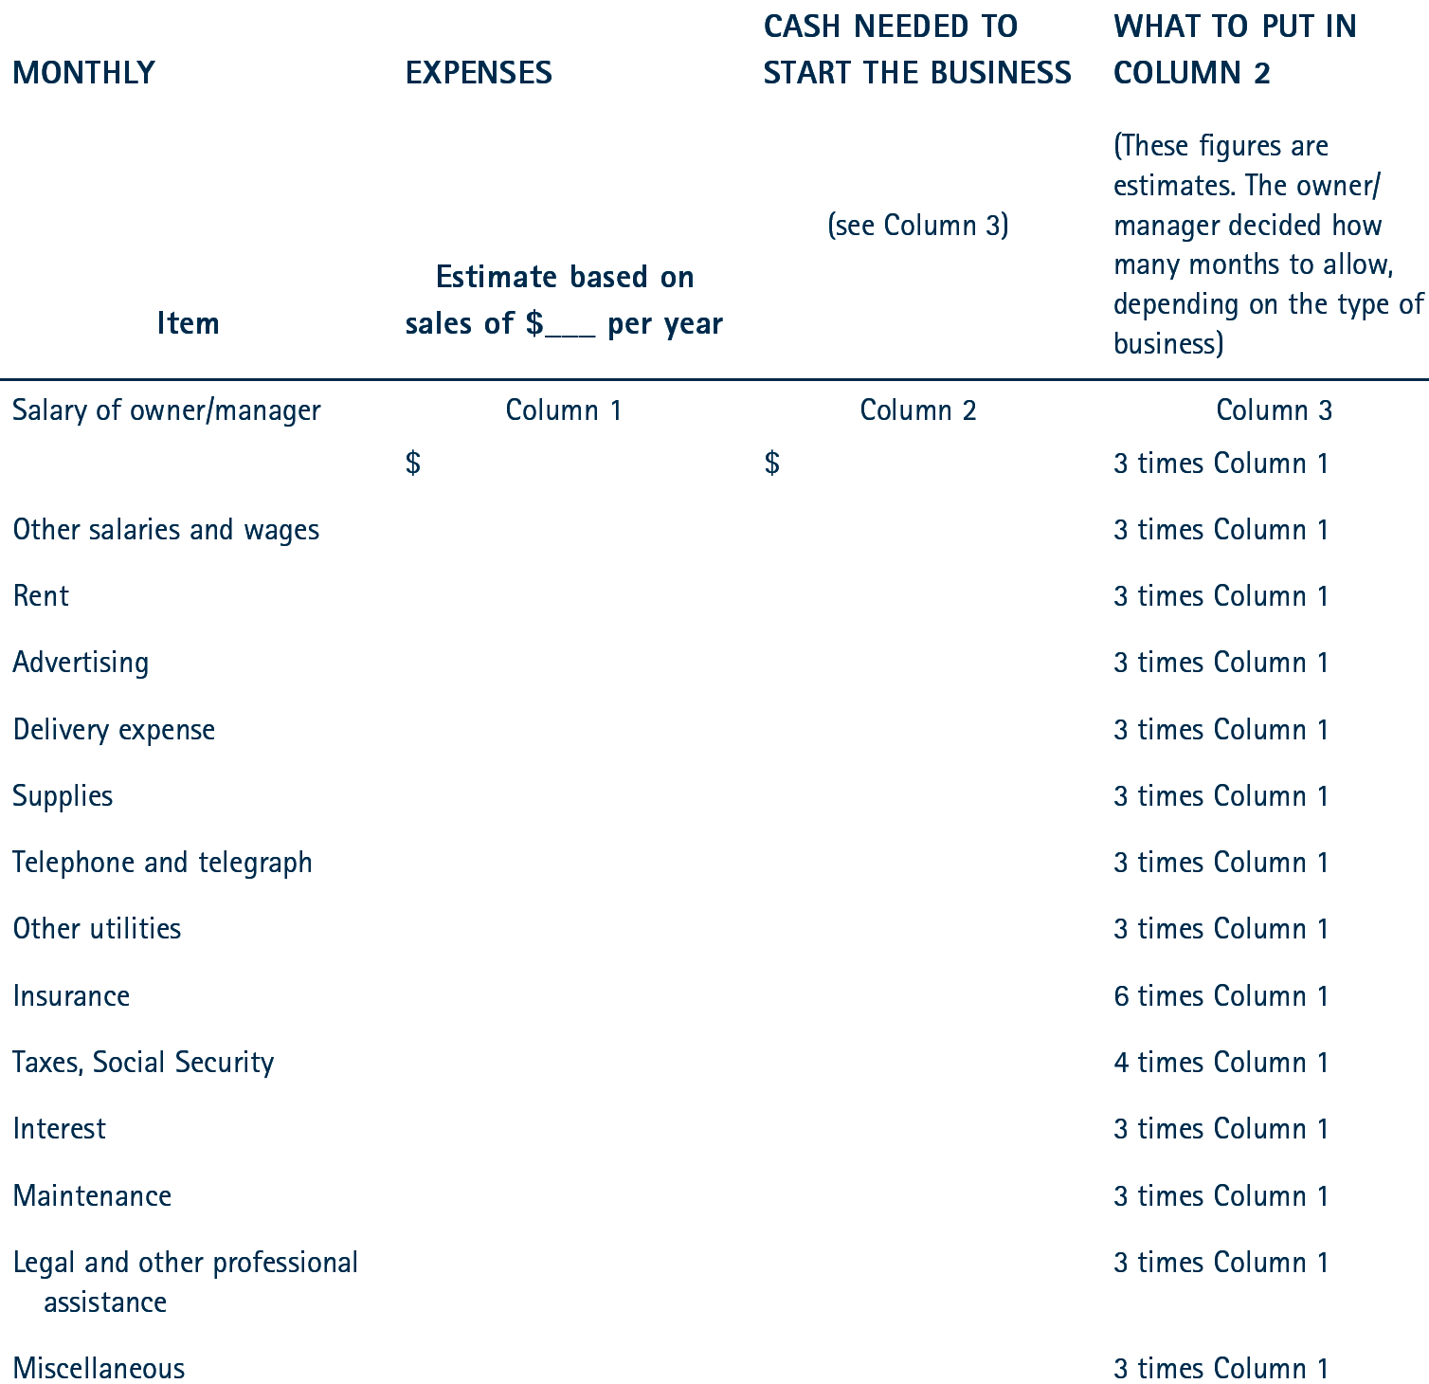
^{Table} 7.2 Checklist for Estimating Start-Up Expenses

Slide 11
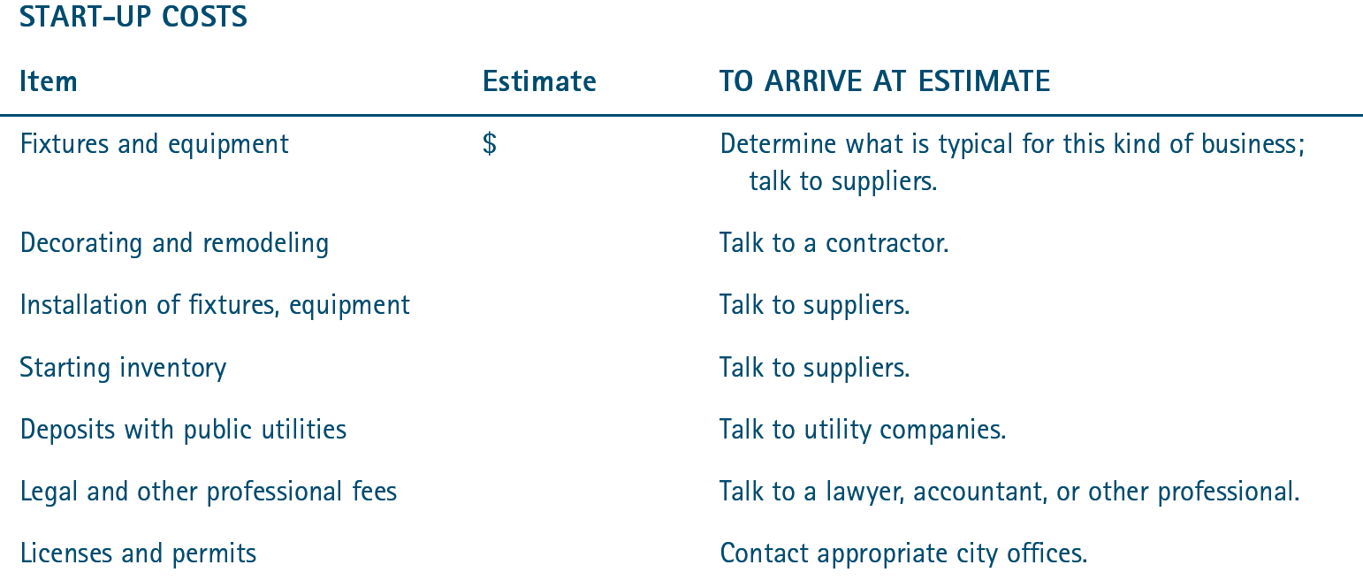
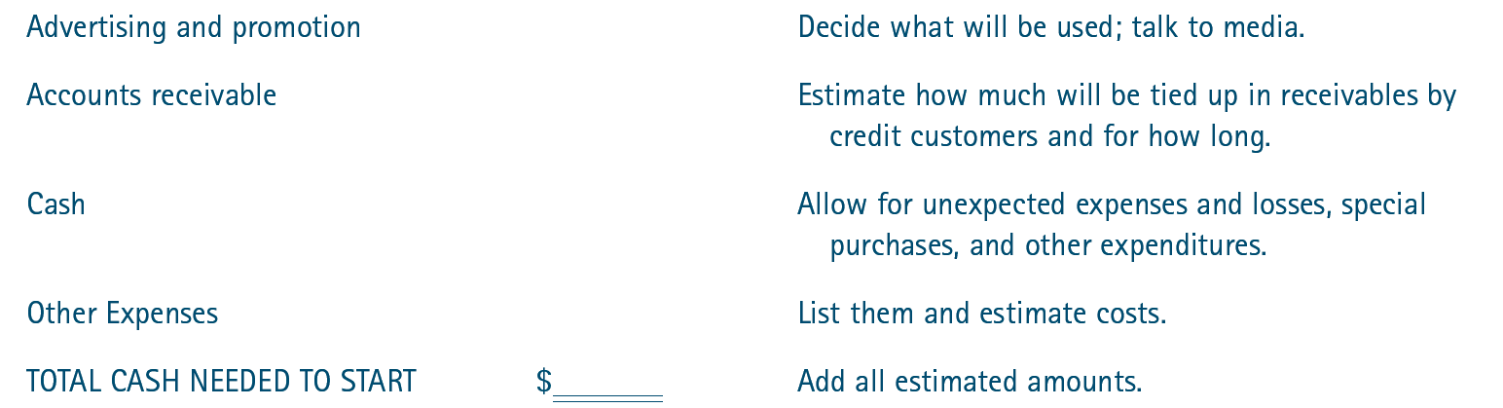
^{Table} 7.2 Checklist for Estimating Start-Up Expenses (cont’d)

Slide 12
Acquisition of an Established Business Venture
Personal Preferences
Acquiring an Established Entrepreneurial Venture
Examination of Opportunities
Evaluation of the Venture
Asking Key Questions

Slide 13
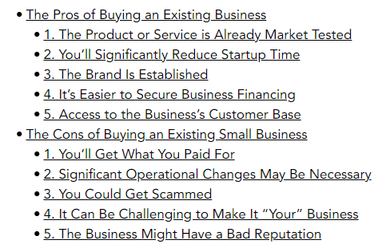
Pros and Cons of Buying Existing Business

Slide 14

Advantages of Acquiring an Ongoing Venture
Less fear about successful future operation
Reduced time and effort
Purchasing at a good price
Buying an Ongoing Venture

Slide 15
Evaluation of the Selected Venture
Factors Affecting Sale of the Venture
The business environment
Assets of the venture
Profits, sales, and operating ratios

Slide 16
Key Questions to Ask
Why is this business being sold?
What is the current physical condition of the business?
What is the condition of the inventory?
What is the state of the other assets of the business?
How many employees will remain with the business?
What type of competition does the business face?
What does financial picture of the business look like?

Slide 17
Negotiating the Deal
Information
Factors Affecting Negotiations
Time
Pressure
Alternatives

Slide 18
Considerations When Buying a Business
Request that the seller retain a minority interest in the business or make the final purchase price dependent on the performance of the business over a three-to-five-year span.
Be wary of any promises made without written corroboration.
Spend time reconstructing financial statements to determine how much cash is actually available.
Interview the owner, vendors, competitors, customers, and employees.

Slide 19
Franchising: The Hybrid
Franchising
Any arrangement in which the owner of a trademark, trade name, or copyright has licensed others to use it in selling goods or services.
Franchisee
A purchaser of a franchise
Franchisor
The seller of the franchise

Slide 20
How Franchising Works
Franchisee Obligations:
Make a financial investment in the operation.
Obtain and maintain a standardized inventory and/or equipment package usually purchased from the franchisor.
Maintain a specified quality of performance.
Follow a franchise fee as well as a percentage of the gross revenues.
Engage in a continuing business relationship.

Slide 21
How Franchising Works (cont’d)
Franchisor Provides:
The company name that provides drawing power.
Identifying symbols, logos, designs, and facilities.
Professional management training for each independent unit’s staff.
Sale of merchandise necessary for the unit’s operation, equipment to run the operation, and the food or materials needed for the final product.
Financial assistance, if needed.
Continuing aid and guidance to ensure that everything is done in accordance with the contract.

Slide 22
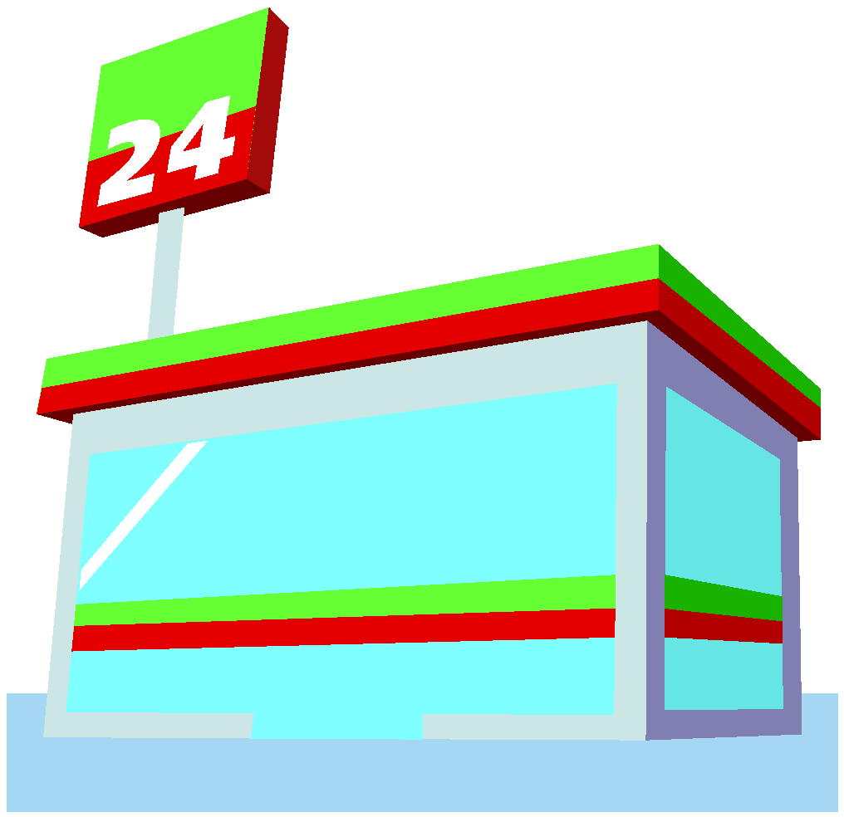
Franchising
Advantages
Training and guidance
Brand-name appeal
A proven track record
Financial assistance
Disadvantages
Franchise fees
Franchisor control
Unfulfilled promises of franchisor

Slide 23
^{Table} 7.3 The Cost of Franchising
The basic franchising fee
Insurance
Opening product inventory
Remodeling and leasehold improvements.
Utility charges
Payroll
Debt service
Bookkeeping and accounting fees
Legal and professional fees
State and local licenses, permits, and certificates

Slide 24

Franchise Law
Franchise Disclosure Document (FDD)
Is divided into 24 items that provide different segments of information for prospective franchisees.
Was developed to provide guidance in complying with the Franchise Disclosure Rule that requires franchisors to make full presale disclosure about their franchises.

Slide 25
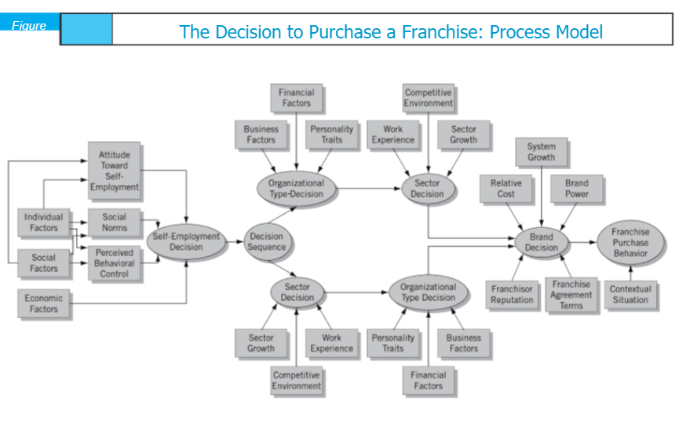

Slide 26
^{Table} 7.4 World Wide Web Franchise Sites
Sites for franchising
http://www.betheboss.com
http://franchise1.com
http://www.franchiseworks.com/
http://franchise.org/

Slide 27
^{Table} 7.4 World Wide Web Franchise Sites (cont’d)
American Bar Association Forum on Franchising | www.abanet.org
U.S. Small Business Administration | www.sba.gov
Statistics – USA | www.stat-usa.gov
Entrepreneur Magazine | www.entrepreneur.com/franchises/bestofthebest/index.html
Minority Business Entrepreneur Magazine | www.mbemag.com
Franchise Times | www.franchisetimes.com
Franchise Update | www.franchise-update.com
Restaurant Business Magazine | www.restaurantbiz.com
Source Book Publications | www.worldfranchising.com
Federal Trade Commission | http://www.ftc.gov/bcp/franchise/netfran.shtm
Franchise.com | http://www.franchise.com/
World Franchising | http://www.worldfranchising.com/
Franchise Solution | http://www.franchisesolutions.com/
Franchise Opportunities | http://www.franchiseopportunities.com/
Franchise Trade | http://www.franchisetrade.com/
The Franchise Magazine | http://www.thefranchisemagazine.net/
Franchise Info Mall | http://www.franchiseinfomall.com/
Franchise Advantage | http://www.franchiseadvantage.com
US Franchise News | http://www.usfranchisenews.com/

Slide 28

Evaluating Franchising Opportunities
The Franchise Opportunity Decision
Finding Reliable Information
Investigating the Franchisor
Seeking Professional Help

Slide 29
Key Terms and Concepts
new-old approach
non-compete clause
profit trend
risk vs. reward
Uniform Franchise Offering Circular (UFOC)
unscrupulous practices
upside gain and downside loss
business broker
franchise
franchisee
franchise fee
franchisor
franchisor control
goodwill
legal restraint of trade
new-new approach
https://www.forbes.com/sites/susanadams/2016/06/22/12-things-to-do-before-you-buy-a-franchise/?sh=21dd74813fe7
POints to be considered before buying a franchise

Slide 30
Business Plan
Marketing plan
Customer analysis
Sales analysis
Competition analysis

Slide 31
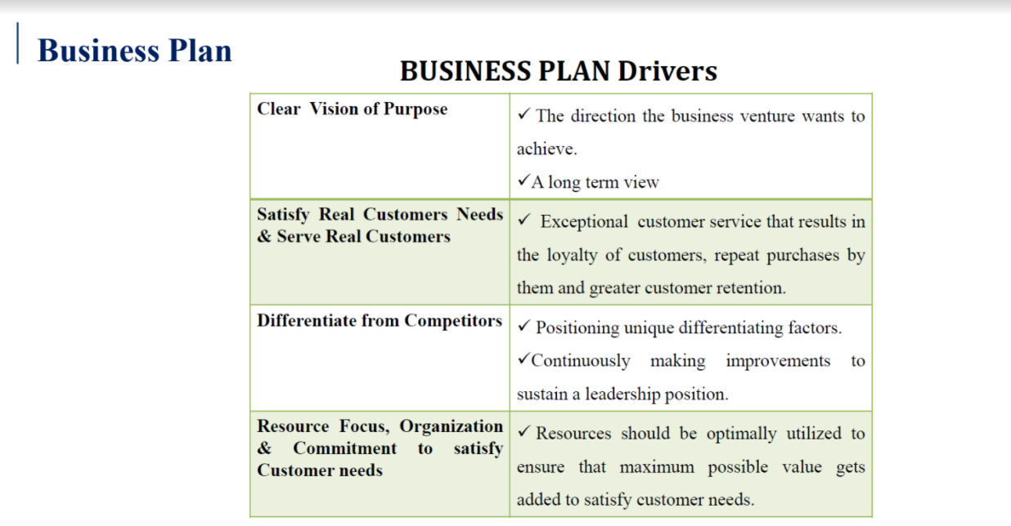

Slide 32
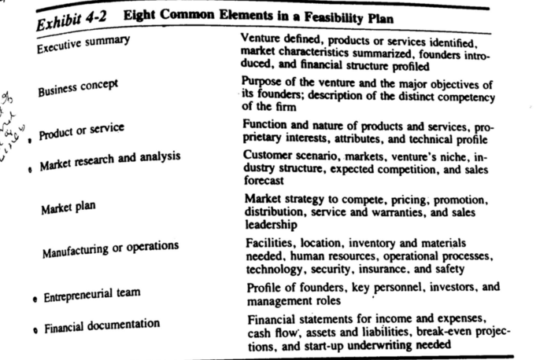

Slide 33
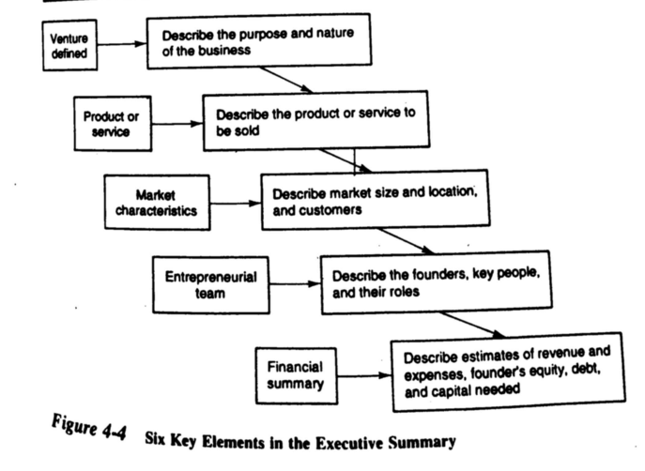

Slide 34
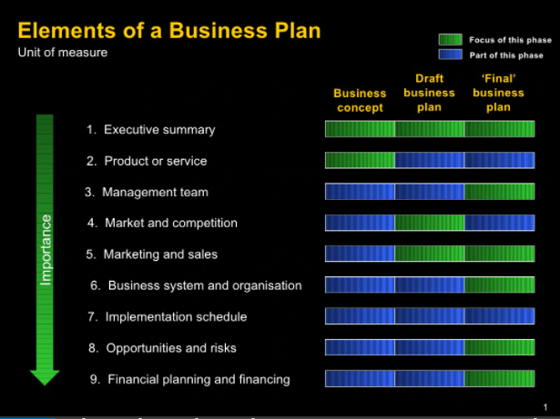

Slide 35
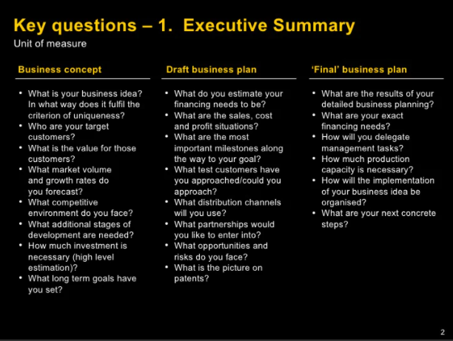

Slide 36
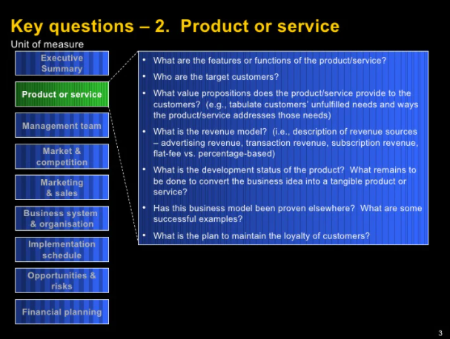
Revenue models
Direct sellers,
Online intermediaries,
Advertising-based
community-based and
Fee-based - subscription based

Slide 37
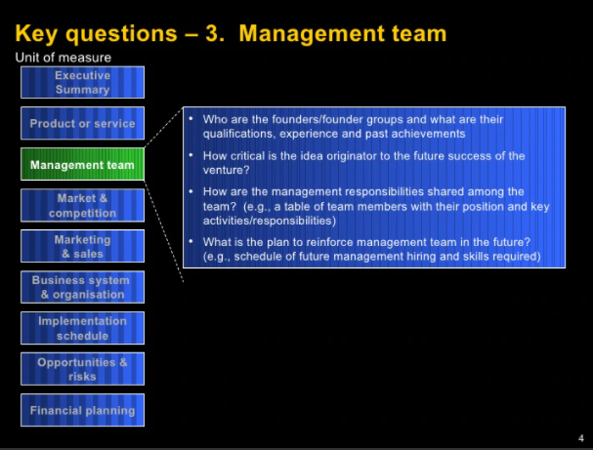

Slide 38
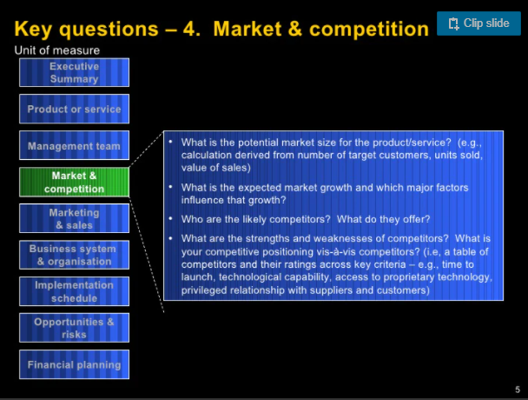

Slide 39
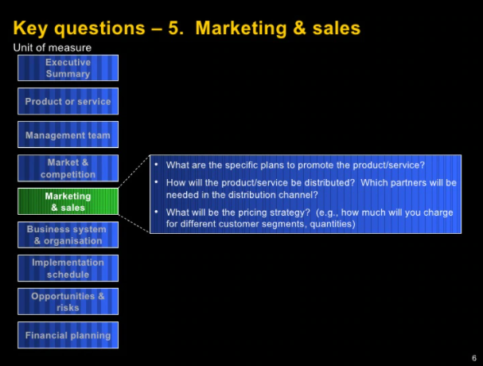

Slide 40
Consumer analysis
Segmentation, targeting and positioning
https://www.youtube.com/watch?v=Fij1aBcl_Ts
Marketing - Mix
https://www.youtube.com/watch?v=p6OIJD3EB4Q

Slide 41
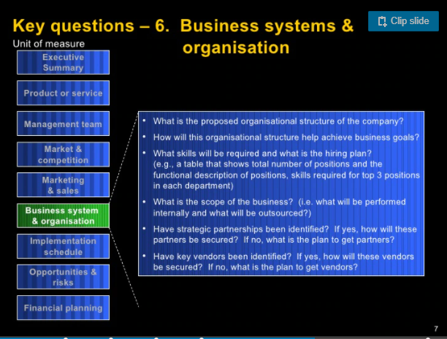

Slide 42
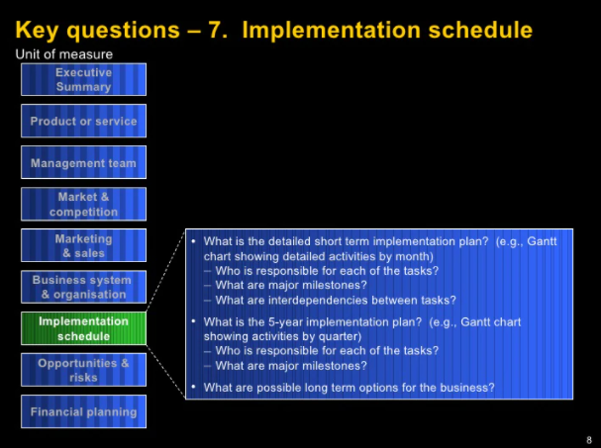

Slide 43
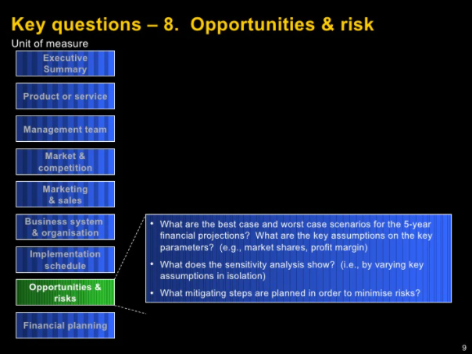

Slide 44
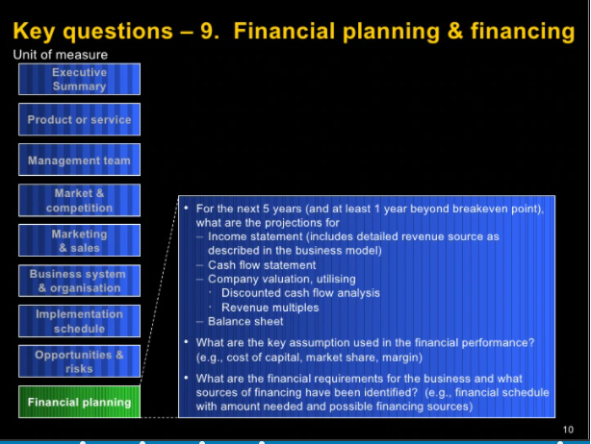

Slide 45
JIO का चौंकाने वाला Business Plan | A Case Study in Hindi | By Dr. Vivek Bindra
https://www.youtube.com/watch?v=EdKjmV5JOPo
Identification of the opportunities:
How Amul beat its competition & made 39,200 Cr during Lockdown? : Business case study
https://www.youtube.com/watch?v=nnwqtZiYMxQ
Branding | Marketing | Positioning | Consumer Behaviour Part 2 | Dr Vivek Bindra
https://www.youtube.com/watch?v=iWuYUhSHXHg

Slide 46
Case-Studies from entrepreneurindia.co
https://drive.google.com/file/d/1yyeH87lsZ-o4IeUTcW2lnJP7xmv1V2gL/view?usp=sharing
https://drive.google.com/file/d/1z2JW7EeuUaOn4b67Q_nWQMzXPaUOjAbd/view?usp=sharing
https://drive.google.com/file/d/1LExnKFRJWl7Y449k-9iQON5s48rNdv1G/view?usp=sharing
https://drive.google.com/file/d/1_aOyJhIvR5qSJ5QArPIGfGGlNNm6FAZ2/view?usp=sharing
https://drive.google.com/file/d/1nWJjiihOHOeQL9rLDZjRxqsdwRoNLSIZ/view?usp=sharing

Slide 47
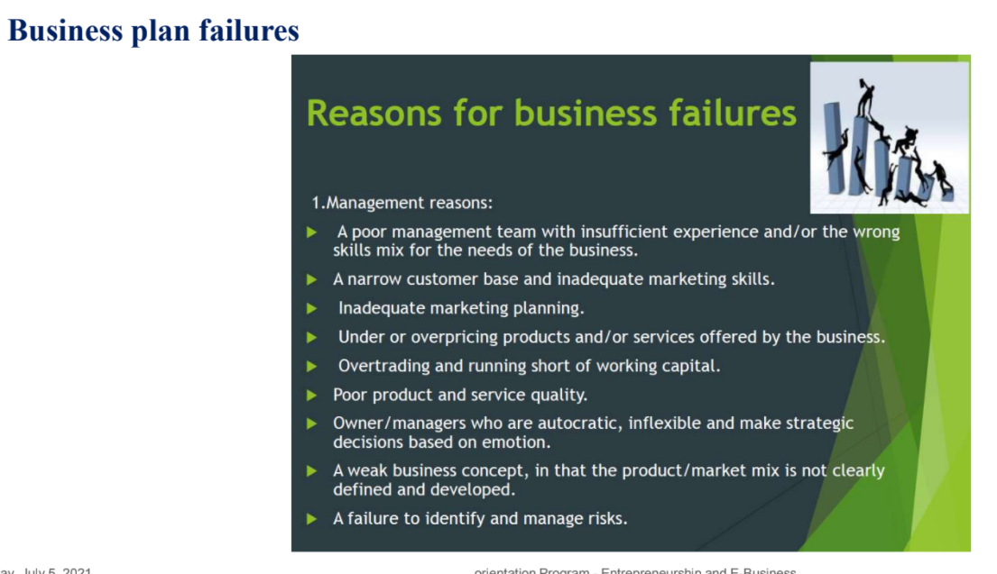

Slide 48
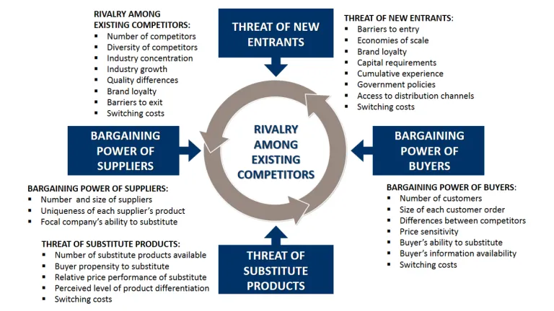
Competition analysis

Slide 49
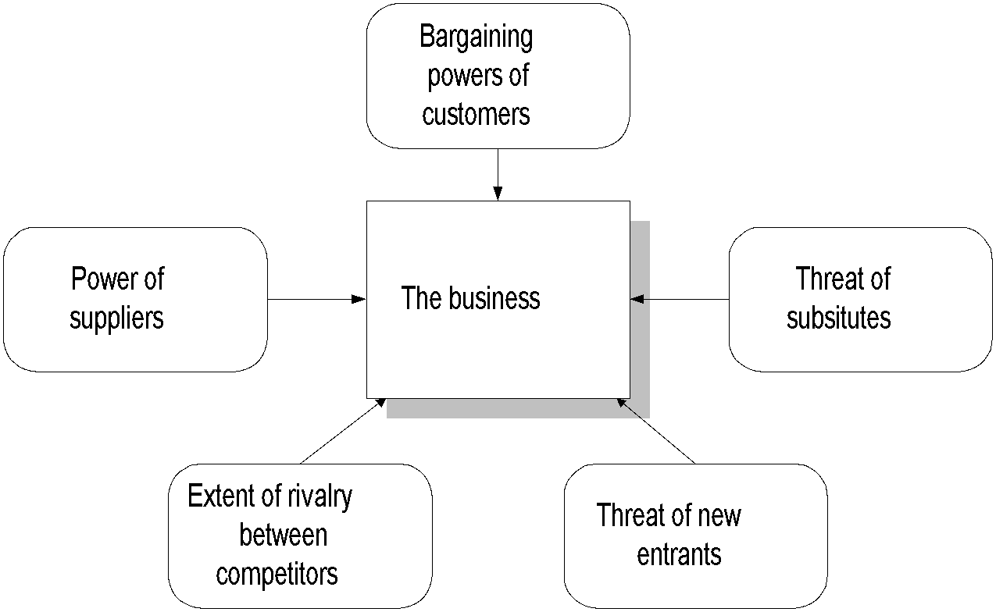
Competitive Environment Analysis Porter’s five forces
Source: adapted with the permission of The Free Press, a Division of Simon & Schuster, Inc., from COMPETITIVE STRATEGY: Techniques for Analyzing Industries and Competitors by Michael E. Porter. Copyright © 1980, 1998 by The Free Press. All rights reserved

Slide 50
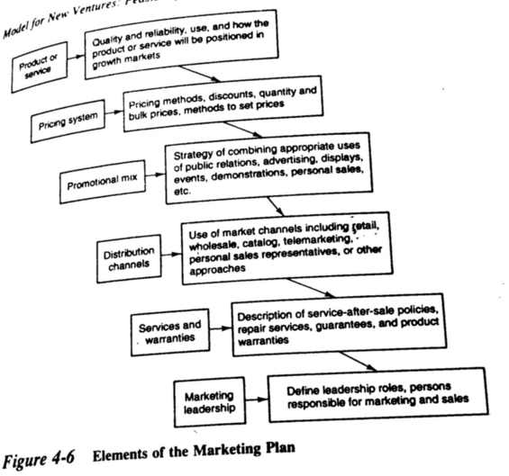
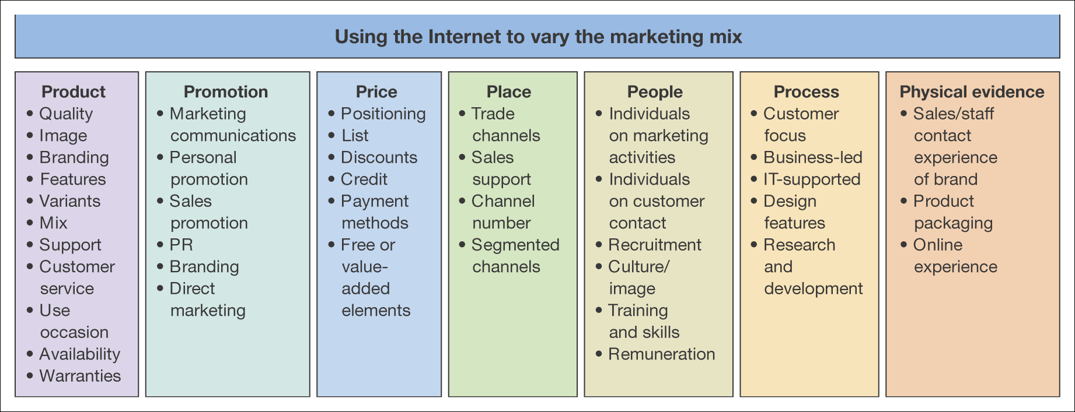

Slide 51
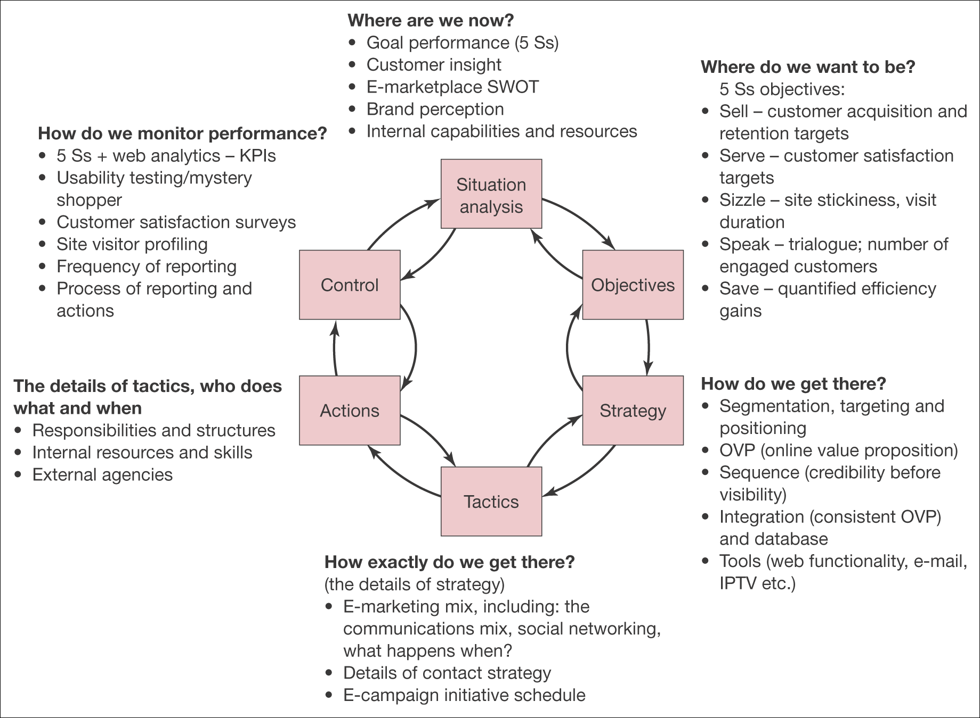
e-Marketing Analysis

Slide 52
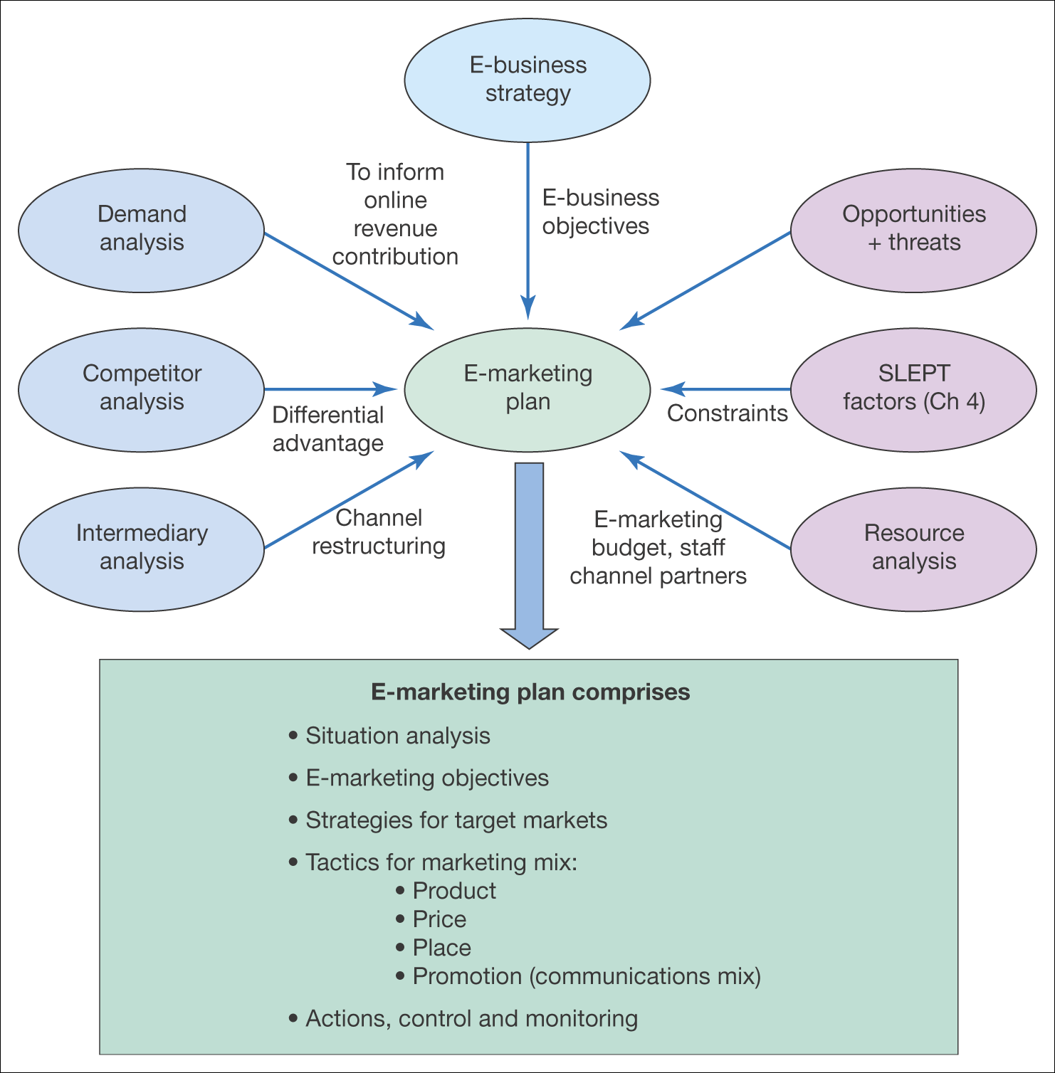
Situation Analysis
Figure 8.5 Inputs to the e-marketing plan from situation analysis

Slide 53
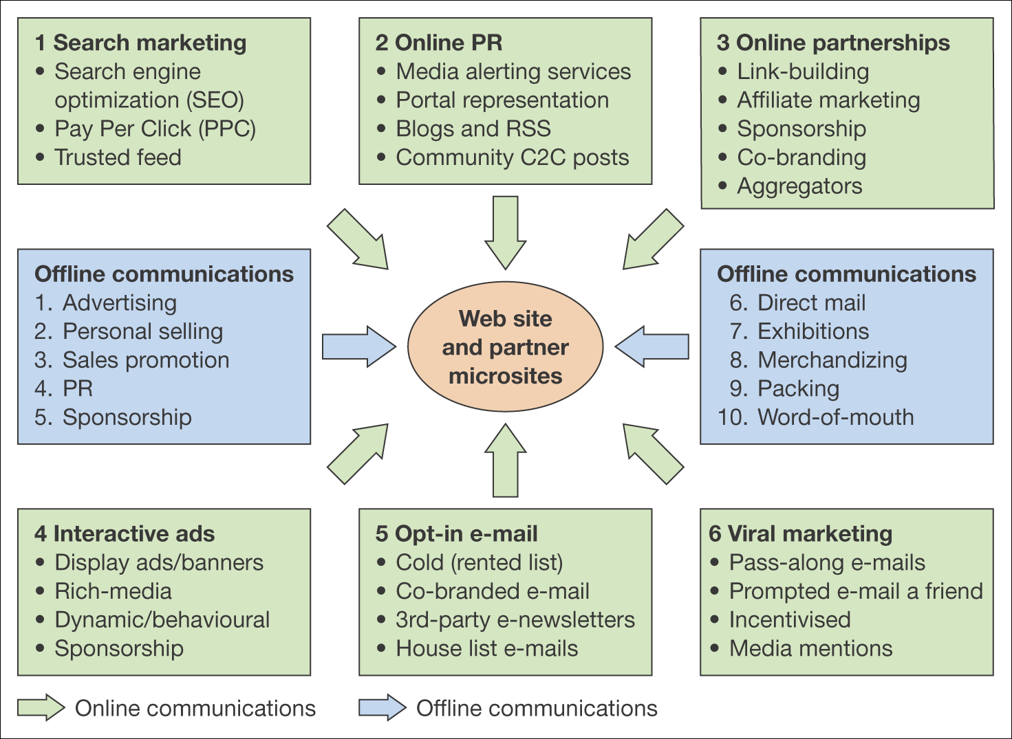

Slide 54
https://www.slideshare.net/sunilzon/elements-of-a-business-plan
Elements of a business plan
https://www.slideshare.net/sunitkapoor1/reasons-of-failure-of-business-47619226
Business plan failure

Slide 55
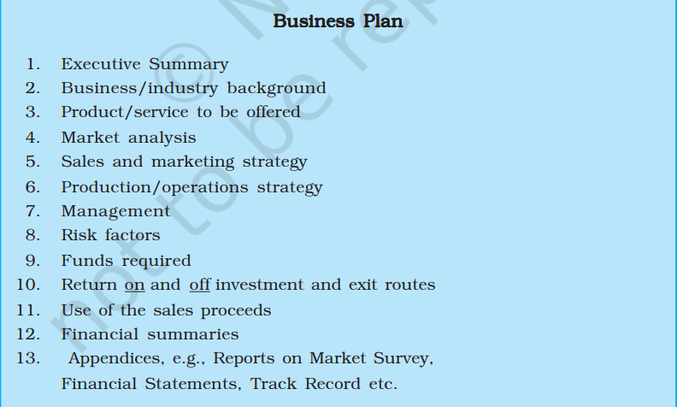
Business plan

